Slide 1
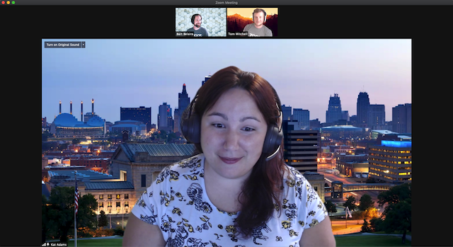
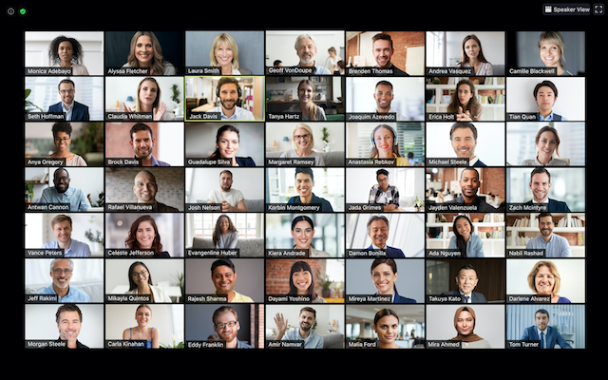
View Options
Located on the top right corner of the screen
Speaker View
Speaker view will switch the large video window between who is speaking with three or more participants in the meeting
Gallery View
Gallery view lets you see thumbnail displays of participants, in a grid pattern, which expands and contracts as participants join and leave the meeting.
Notes:
View Options:
Located on the top right corner of the screen
Speaker View
Speaker view will switch the large video window between who is speaking with 3 or more participants in the meeting
Gallery View
Gallery view lets you see thumbnail displays of participants, in a grid pattern, which expands and contracts as participants join and leave the meeting.

Slide 2
Spotlighting and Pinning
Spotlighting
Only Host or Co-host can spotlight someone
​Whoever is spotlighted will appear in Speaker View
Pinning
Any participant can pin any other participant’s video at any time, and only impacts that participant’s display
How to Spotlight/Pin Participants
Hover over participant you want to spotlight/pin
Select the parenthesis (…)
From the menu, choose “Spotlight for Everyone” or “Pin”
Notes:
Spotlighting and Pinning
Spotlighting
Only Host or Co-host can spotlight someone
​Whoever is spotlighted will appear in Speaker View
Pinning
Any participant can pin any other participant’s video at any time, and only impacts that participant’s display
How to Spotlight/Pin Participants
Hover over participant you want to spotlight/pin
Select the parenthesis (…)
From the menu, choose “Spotlight for Everyone” or “Pin”

Slide 3
Live Captions Provided
Two Options:
Access StreamText link available in the “Chat” (“Chat” control in Zoom toolbar)
Access the “Closed Captions” option (“Closed Captions” control with “CC” above it in Zoom toolbar)
Notes:
Live Captions Provided:
Two Options:
Access StreamText link available in the “Chat” (“Chat” control in Zoom toolbar)
Access the “Closed Captions” option (“Closed Captions” control with “CC” above it in Zoom toolbar)

Slide 4
Zoom, Microsoft Teams, and Website Accessibility Tips During a Pandemic
John Rempel

Slide 5
Spotlighting and Pinning
Spotlighting
Only Host or Co-host can spotlight someone
​Whoever is spotlighted will appear in Speaker View
Pinning
Any participant can pin any other participant’s video at any time, and only impacts that participant’s display
How to Spotlight/Pin Participants
Hover over/place focus on participant you want to spotlight/pin
Select the ellipsis (…)
From the menu, choose “Spotlight for Everyone” or “Pin”

Slide 6
Agenda
Brief Overview of AccessGA and CIDI
Walkthrough of Teams and Zoom
Recent MS Teams and Zoom Initiatives
Overview of MS Teams
Overview of Zoom
Accessibility Features in MS Teams and Zoom
Accessibility Features that Transfer to Other Digital Environments

Slide 7
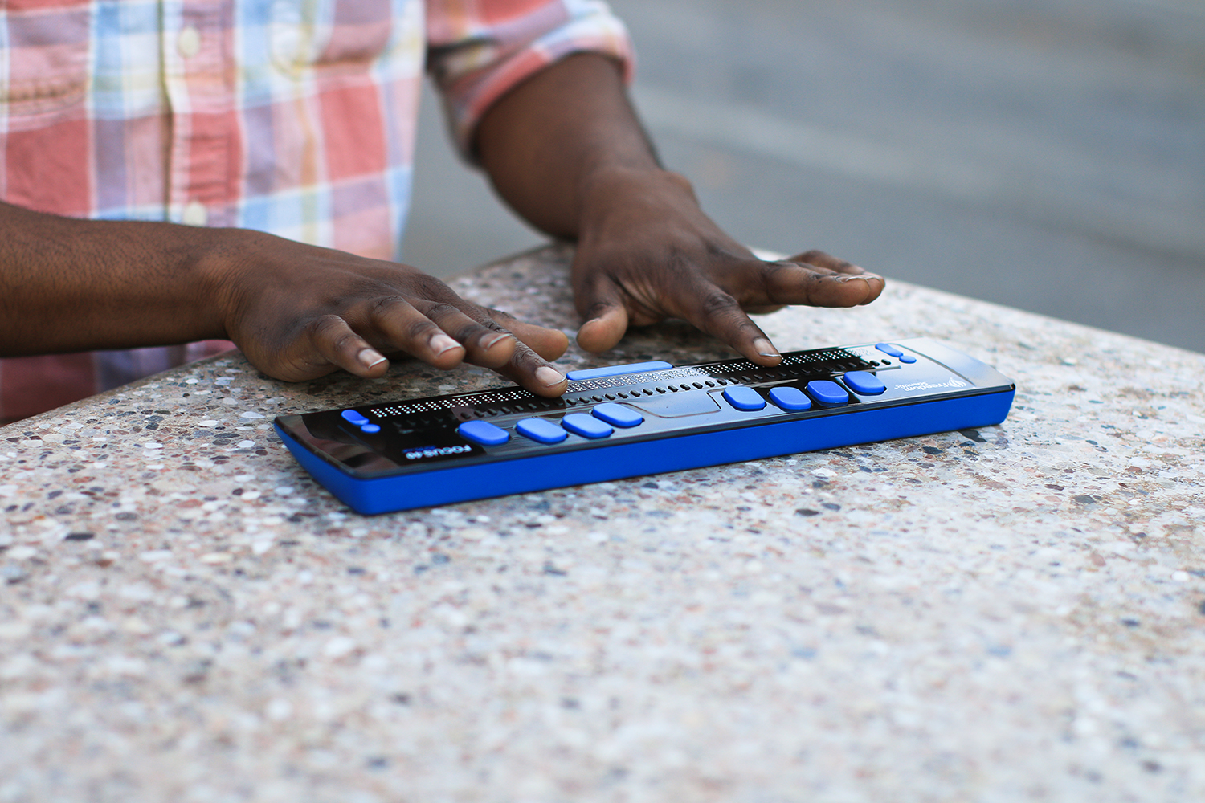
Center for Inclusive Design & Innovation
Center for Inclusive Design & Innovation (CIDI) provides practical solutions for challenges faced daily by individuals with disabilities.
We focus on solutions that offer utility, usability, and durability.
CIDI offers services including disability compliance consultation, braille, captioning, accessible digital content, and assistive technology.

Slide 8
The AccessGA Initiative

Slide 9
What is AccessGA?
AccessGA is a joint initiative of the State of Georgia ADA Coordinator’s Office, and CIDI.
The objective is to support Georgia state agencies that strive to provide equitable and timely access to their employees, students, and clients with a wide range of disabilities.
Benefits and Services Include…
Access to live webinars and archived webinars
Technical assistance and hands-on training
Web accessibility evaluations and resources
Periodic newsletters
Up-to-date wiki of ICT accessibility resources and information
Special events

Slide 10
WAG Web Accessibility Group
Its purpose is to bring together individuals in Higher Ed seeking to navigate the complex requirements of state and federal accessibility standards and guidelines.
Housed at the Center for Inclusive Design & Innovation (formerly AMAC Accessibility) at Georgia Tech
Focus on web accessibility for higher-ed
WAG listserv discussion and technical guidance
WAG website http://www.amacusg.org/wag

Slide 11
The Legal Landscape During a Pandemic
Spring, 2020: Petition started by Blogger Shari Eberts
Founder of an online community called Living With Hearing Loss.
December, 2020: Two deaf men filed federal lawsuit against Zoom due to lack of captions
Lawsuit asserts violation of the Americans with Disabilities Act

Slide 12
Virtual Access During a Pandemic
Opportunity to learn from employees with disabilities
Captioning, sign language, audio description, screen reader/keyboard-only access, platform’s accessibility standards
Provide effective means of employees’ abilities to reach out, including email, chat room, phone, screen sharing
Consider re-examining procurement process, and if necessary, strengthening with people with disabilities in mind

Slide 13
Participant Feedback

Slide 14
Overview of Microsoft Teams
Microsoft Teams is a business communication platform that is included in the Microsoft 365 family.
Multi-platform Access (Windows, Mac, iOS, Android)
Features:
Video conferencing
File sharing
Screen sharing
Live chat
Voice and video calling
Webinars

Slide 15
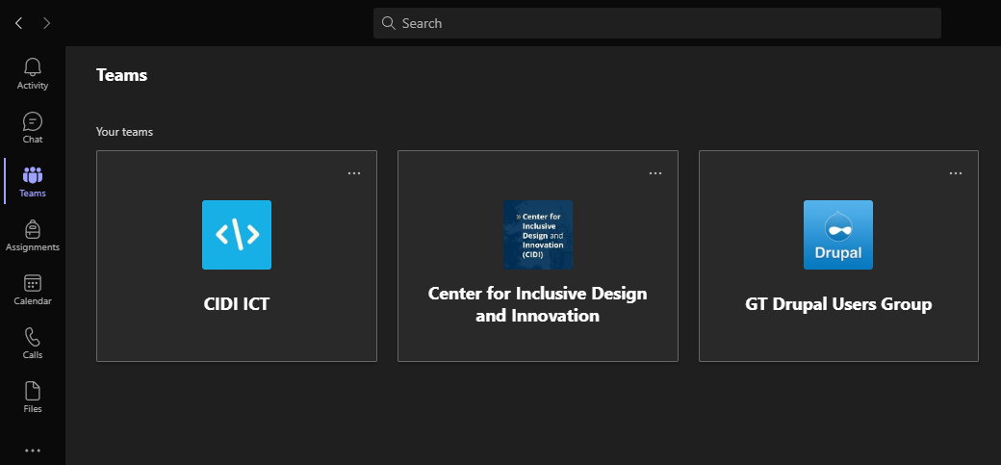
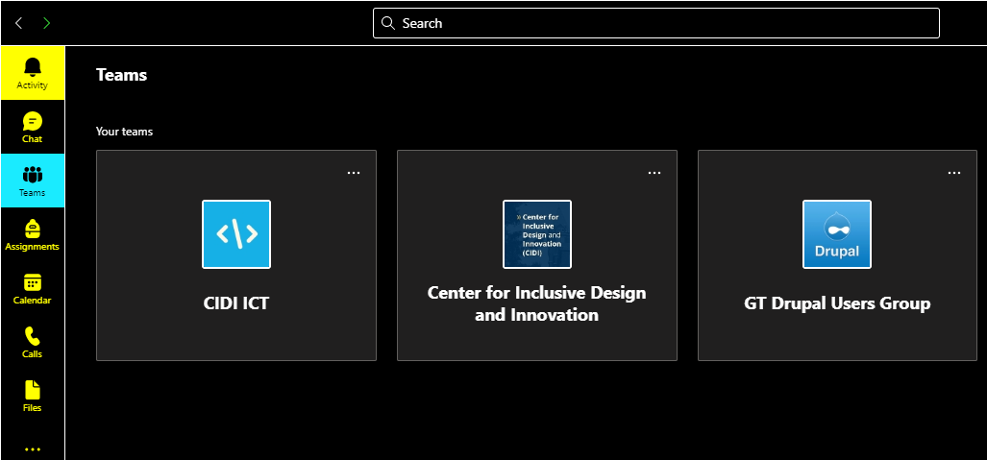
Color Contrast – Microsoft Teams
Dark and High Contrast Modes are supported on Windows and Mac platforms

Slide 16
Keyboard Accessibility – Microsoft Teams
Keyboard shortcuts are provided on Microsoft Teams’ community website
Keyboard shortcuts for meetings and calls are limited
Some aspects are non-intuitive (for example, some controls such as buttons are accessed via left/right arrow keys vs. tab key)

Slide 17
Microsoft Teams Screen Reader Compatibility
Microsoft Teams is compatible with JAWS and NVDA
Microsoft’s site confirms that the platform has been tested with both screen readers
Lack of documentation for compatibility with VoiceOver

Slide 18
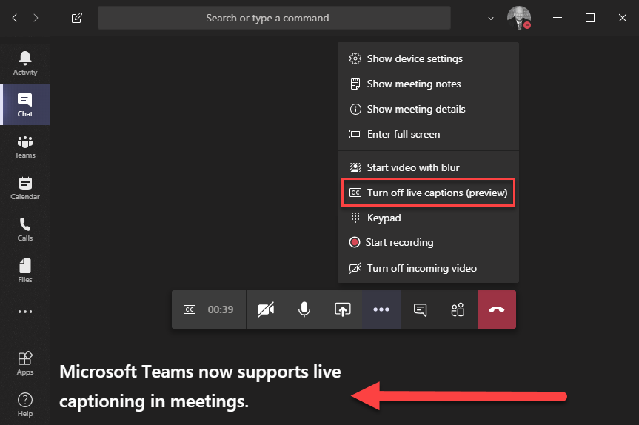
Captioning – Microsoft Teams
Captions are auto-generated by the Microsoft Automatic Speech Recognition service
Accuracy can be compromised
May not be acceptable for critical information and educational purposes
There is not an option to add a captionist to meetings and/or calls

Slide 19
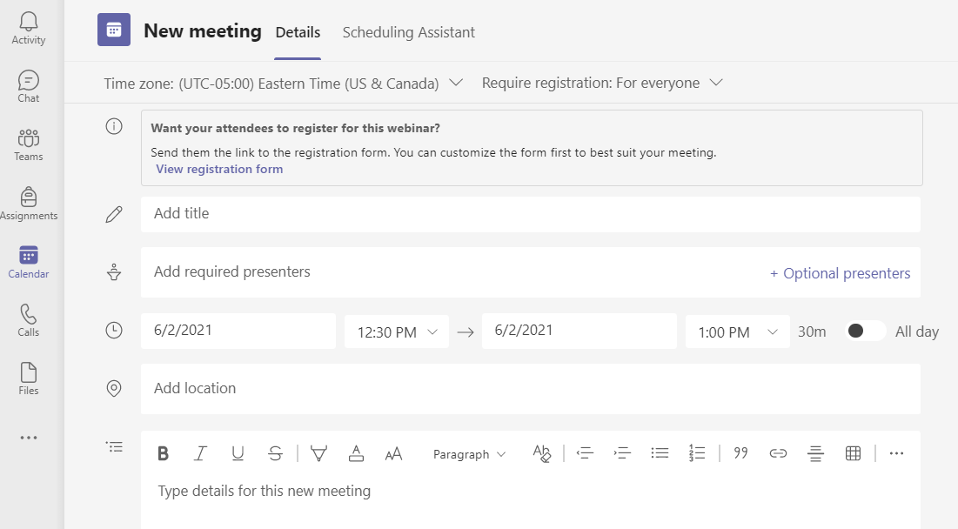
Leveraging MS Teams as Webinar Platform
Registration required
Process is closely tied to the Microsoft ecosystem
Allows up to 1,000 attendees to interact
Allows up to 10,000 attendees in viewing mode only

Slide 20
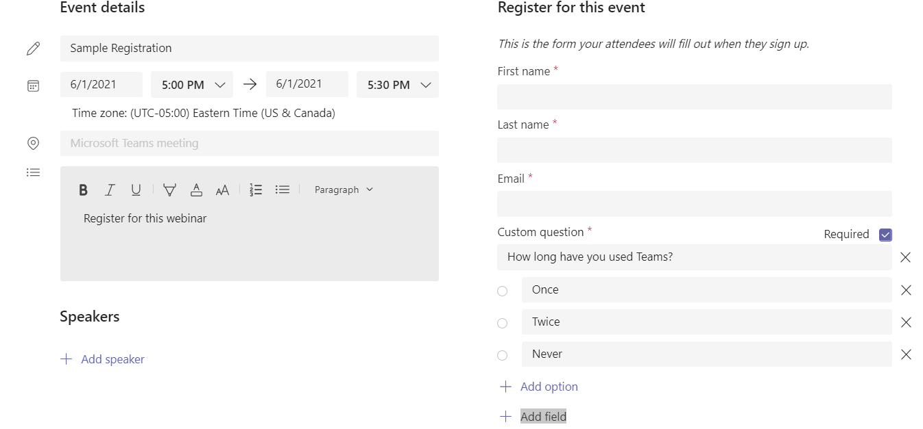
Registration using Teams
Limited in functionality
Only allows for edit fields and radio buttons, no checkboxes or dropdown menus
Weak contrast levels on page

Slide 21
MS Teams Misc. Accessibility Features and Tips
Content magnification via Zoom In/ Zoom Out feature using Control + Spin Wheel
Focus Mode and Full Screen Mode allow for removal of distractions
Indication to screen reader user whether the camera is enabled or not when entering a meeting
Tip: When sharing your screen, remember to enlarge the content
Tip: When others enter the room in smaller meetings, acknowledge their presence since Teams does not indicate when people enter/leave a room

Slide 22
Overview of Zoom
Zoom is a video communication platform created in 2011 by Eric Yuan
Multi-platform access:
Windows
Mac
iOS
Android
Features:
Teleconference Calls
Webinars
Live Chats
Screen-sharing

Slide 23
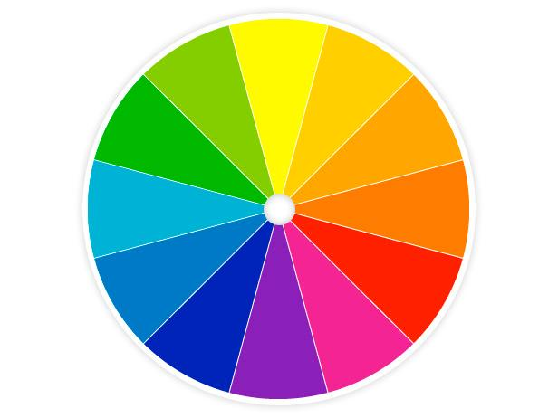
Color Contrast - Zoom
Dark Mode is supported on MacOS
High Contrast Mode is supported on the following platforms:
Windows
iOS
Android
Zoom’s standard UI color contrast is excellent

Slide 24
Keyboard Accessibility - Zoom
Keyboard shortcuts are made available from Zoom’s website
Extensive keyboard shortcuts for all aspects of the platform (meetings, calls, etc.)
Logical and easy to use shortcut keys (e.g., Alt + A for audio, Alt + V for video)

Slide 25
Zoom’s Screen Reader Compatibility
According to their website, Zoom is compatible with JAWS, NVDA, VoiceOver and Android Talkback
There are exceptions to this compatibility
Control panel is unreachable for keyboard users and screen reader users when hidden
Zoom’s remote control features allow for control of the screen sharer’s screen reader

Slide 26
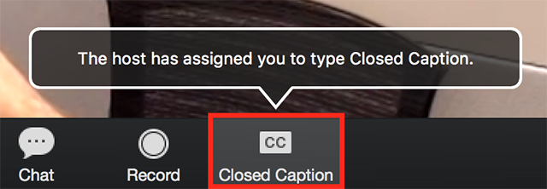
Captioning - Zoom
Live captioning is available for all users regardless of membership type
Captions can be provided by meeting participants or a third-party service
This Fall, Zoom will be releasing its auto-generated captioning feature for all users
Transcripts are provided at the end of the meeting

Slide 27
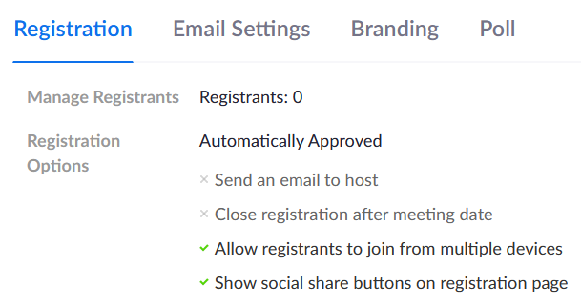
Registration using Zoom
Only available with paid license
Only allows for edit fields and single choice options
Link to meeting can be shared with others which will duplicate registration information and name

Slide 28
Zoom’s Misc. Accessibility Features and Tips
Customizable font allows users to change the size and color of the font in the platform
Sign language interpreters can be added to the meeting
The video pinning feature can be used to keep the interpreter in view
Tip: Many features and options of Zoom are available only in the web-based application, not the desktop application
Tip: If meeting attendees need captioning, it is necessary for the administrator to enable the “closed caption” feature available in the web-based application before starting the meeting
Tip: Keyboard-only and screen reader users should enable the “always on” function of their control panel to ensure access during meetings

Slide 29
Mobile Accessibility for Teams and Zoom
Desktop accessibility features roll into mobile accessibility
Native apps available that are highly accessible
Responsive design

Slide 30
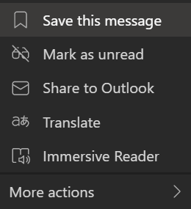
Microsoft Teams Message Translator
Allows users to translate messages sent to them in Teams to their preferred language.
Currently available on desktop.
Support for 30+ languages
Will be rolled out to mobile devices in July.
Android and iOS
Support for 70+ languages
Language support for mobile and desktop include Spanish, Arabic, and Chinese.

Slide 31
Microsoft Teams Resources
Screen Reader Instructions: https://support.microsoft.com/en-us/office/use-a-screen-reader-to-explore-and-navigate-microsoft-teams-47614fb0-a583-49f6-84da-6872223e74a0
Tips for accessible live events and meetings: https://support.microsoft.com/en-us/office/accessibility-tips-for-inclusive-microsoft-teams-meetings-and-live-events-fa0cb694-0fcd-4019-b67c-8270ea4e0c54
Keyboard Shortcuts: https://support.microsoft.com/en-us/office/keyboard-shortcuts-for-microsoft-teams-2e8e2a70-e8d8-4a19-949b-4c36dd5292d2#picktab=windows
MS Teams Accessibility YouTube Videos: Accessible Learning Webinar Series on Microsoft Teams
Microsoft Disability Answer Desk (DAD) is a free service for people with disabilities in need of technical support with Microsoft products. DAD is offered in multiple languages, in ASL, and through chat

Slide 32
Zoom Resources
Zoom Accessibility Home Page: https://zoom.us/accessibility
Managing and viewing captions: https://support.zoom.us/hc/en-us/articles/207279736-Managing-and-viewing-closed-captioning
Frequently Asked Questions: Zoom Accessibility Frequently Asked Questions

Slide 33
Maintaining Accessibility Across Other Digital Environments

Slide 34
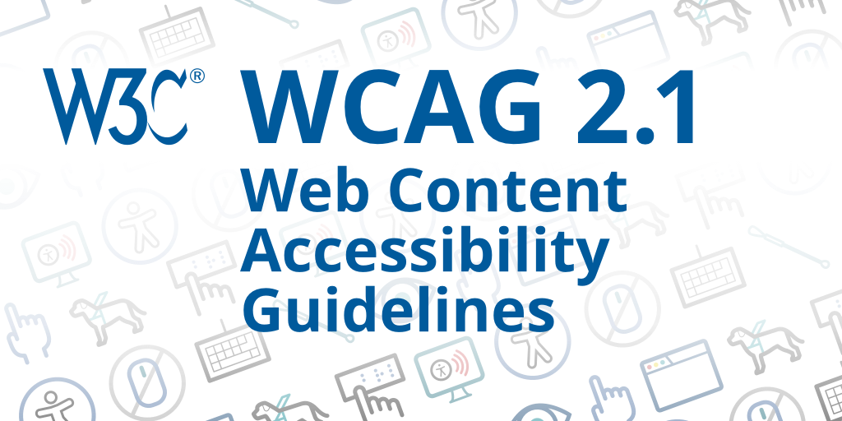
WCAG 2.0 (Level A/AA)
The World Wide Web Consortium’s Web Accessibility Initiative (W3C-WAI) developed Content Accessibility Guidelines (WCAG).
WCAG 2.0: published as a final W3C recommendation in December, 2008
WCAG 2.1 published in June, 2018 - incorporates WCAG 2.0 with updates related to mobile accessibility, people with low vision, and people with cognitive and learning disabilities
Level A: Essential requirements to meet, otherwise it will be impossible for one or more groups to access the web content.
Level AA: Necessary requirements to meet, otherwise some groups will find it difficult to access the web content.

Slide 35
White House Accessibility Statement
White House Accessibility Statement
“Our ongoing accessibility effort works towards conforming to the Web Content Accessibility Guidelines (WCAG) version 2.1, level AA criteria. These guidelines not only help make web content accessible to users with sensory, cognitive and mobility disabilities, but ultimately to all users, regardless of ability.”

Slide 36
WCAG Guidelines
Perceivable
Content should be able to be perceived by all users
Operable
Content should be able to be operated by all users
Understandable
Content should be understandable to all users
Robust
Content must be robust enough that it can be interpreted reliably by a wide variety of user agents, including assistive technologies.

Slide 37
Alternative Text on Images
All images should have an alt text attribute
Alt text should be descriptive
Length and level of description are subject to the image and its purpose
Decorative images should have an empty alt text attribute (i.e. alt=“”, no spaces)
<p> <img src="dog.jpg" alt="Dog with a bell attached to its collar."> Off-duty guide dogs often wear ... </p>

Slide 38
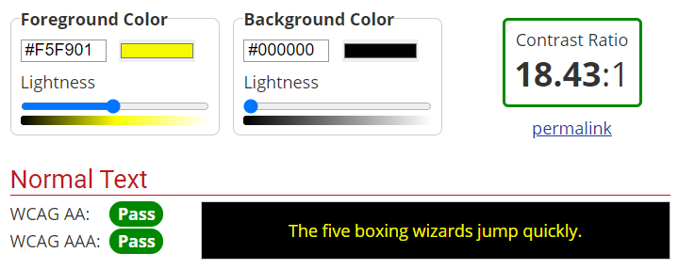
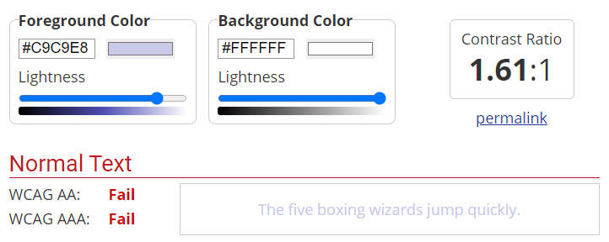
Color Contrast of Text
Text should have a color contrast ratio of at least 4.5:1
Exceptions
Large text (at least 18pt font or bold 14pt font)
Text that is part of a logo or branding

Slide 39
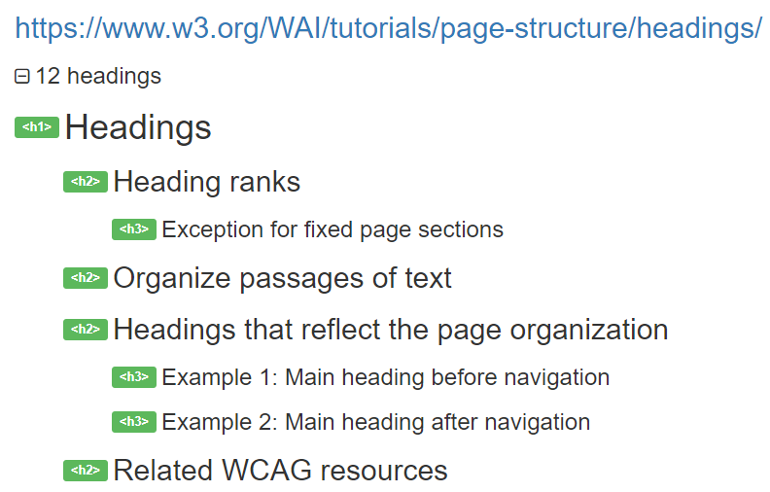
Heading Structure
Headings should be nested by their level
H1 → H2 → H3
Skipping heading levels can be confusing for screen reader users

Slide 40
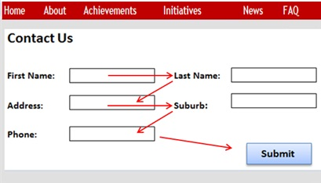
Focus Order and Visible Focus
Keyboard focus should follow a logical path (left, right, top, bottom)
Hidden content should not be able to receive keyboard focus
Elements on the page that can be tabbed to requires visible focus

Slide 41
Resources
WCAG 2.0: https://www.w3.org/TR/WCAG20/
WCAG 2.1: https://www.w3.org/TR/WCAG21/
WCAG 3 Working Draft: https://www.w3.org/TR/wcag-3.0/
The WCAG Quick Guide: https://www.w3.org/WAI/WCAG21/quickref/
W3C-WAI Accessibility Principles: https://www.w3.org/WAI/fundamentals/accessibility-principles/
AccessGA Website: http://www.accessga.org
Color Contrast Analyser: https://developer.paciellogroup.com/resources/contrastanalyser/

Slide 42
Questions?

